Slide 1
Editing V/S Proofreading: A Case of Manuscript

Slide 2
Proofreading:
Verifies editing changes
Addresses overlooked errors
Compares “dead” copy to current copy
Looks for accuracy in spelling, numbers, and consistency

Slide 3
Editing vs. Proofreading
editing
Proofreading
Prepares text for publication
Makes style choices
Occurs early in production
Uses interlinear marks when possible
Verifies that editing specifications have been implemented
Occurs toward the end of production
Uses mostly marginal marks

Slide 4
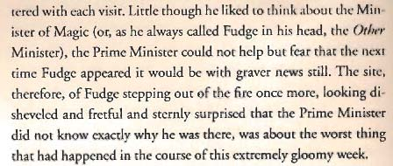
Uncaught errors spoil the mood…
Rowling, J.K. 2005. Harry Potter and the Half-Blood Prince. New York: Arthur E. Levine, p. 10.

Slide 5
…cause confusion…

Slide 6
…or ruin careers.
“Career break in 1999 to renovate my horse”
“1990 – 1997: Stewardess – Royal Air Force”
Hobbies: “enjoy cooking Chinese and Italians”
“Service for old man to check they are still alive or not.”
Cleaning skills: “bleaching, pot washing, window cleaning, mopping, e.t.c”
“Job involved…counselling clientele on accidental insurance policies available”
“2001 summer Voluntary work for taking care of the elderly and vegetable people”
“I’m intrested to here more about that. I’m working today in a furniture factory as a drawer”

Slide 7
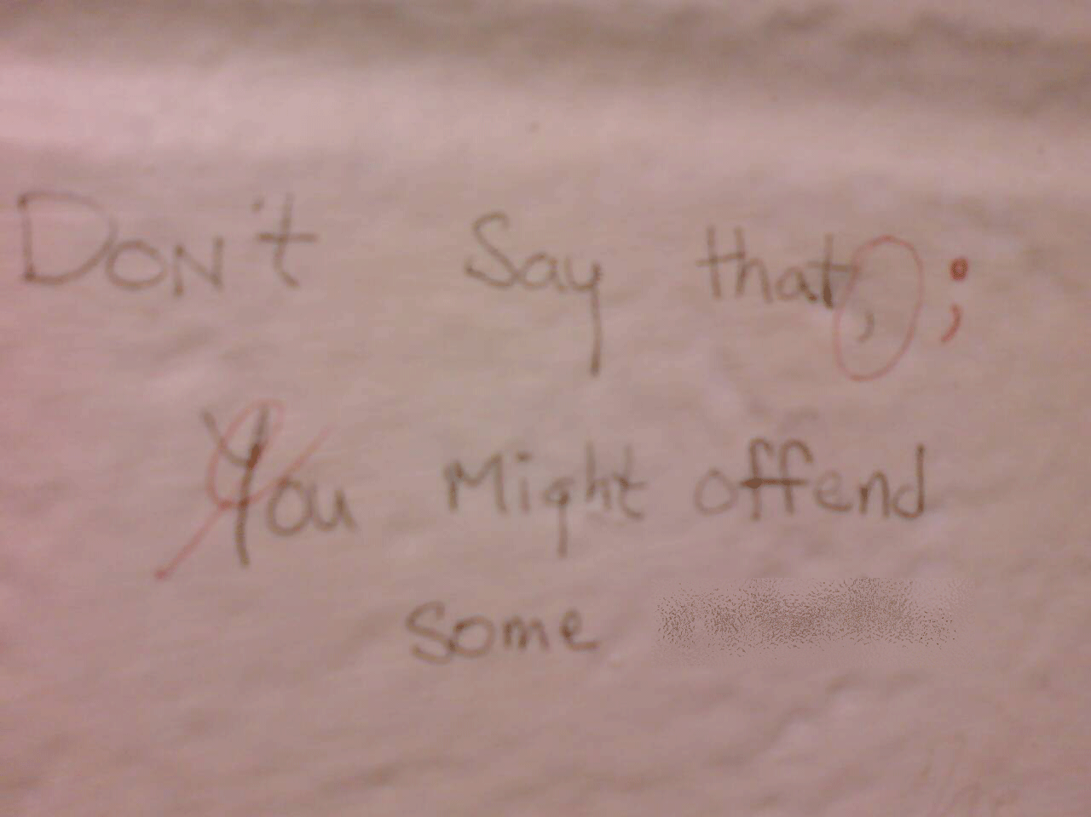
Catching errors gives readers a sense of superiority.

Slide 8
Proofing marks are somewhat different from editing marks
Mistakes in a line may be listed left to right with a slash between corrections
Marginal marks should be in the margin closest to the mistake
Corrected versions may be written out in margin
See pp. 218-220 in textbook.

Slide 9
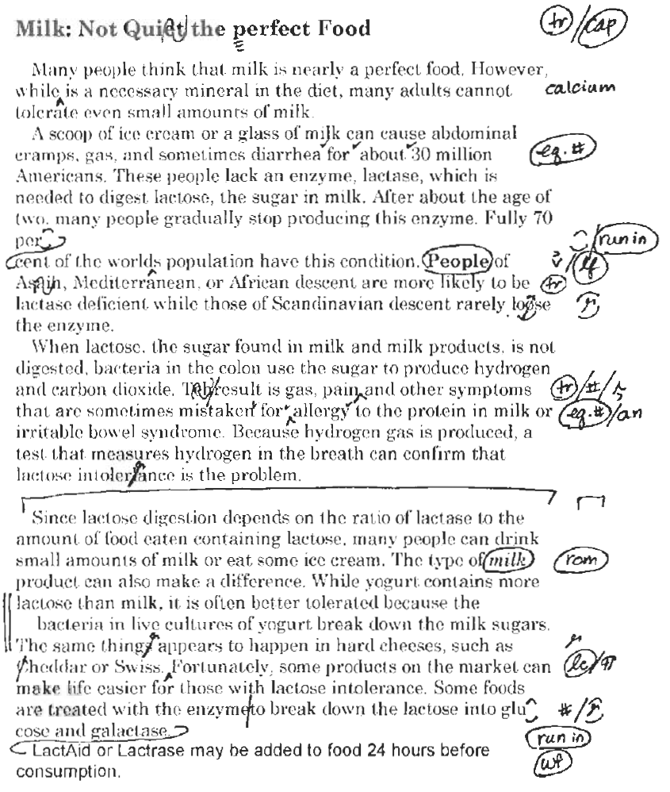
Rude, Carolyn. Technical Editing, 4th ed., p. 223

Slide 10
Helpful Proofreading Tips
Check original copy & editing marks when possible
Pay attention to text other than body copy
If you find one error, look for more
Review text purely on a visual basis at least once
Check hyphenation
Use techniques to force slow reading
Use multiple proofreaders
Don’t proofread when tired

Slide 11
Read. Write. Revise-proofread.

